Slide 1
2D Image Segmentation with Graph Cuts
Vikram PT

Slide 2
Image Segmentation
It is the process of partitioning a digital image into subgroups of similar characteristics
Image segmentation could involve separating foreground from background, or clustering regions of pixels based on similarities in color or shape.
Once the object(s) of interest have been extracted from an image, they can be used to improve downstream tasks like object recognition/classification

Slide 3
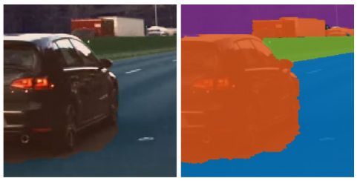
Applications
Autonomous Driving

Slide 4
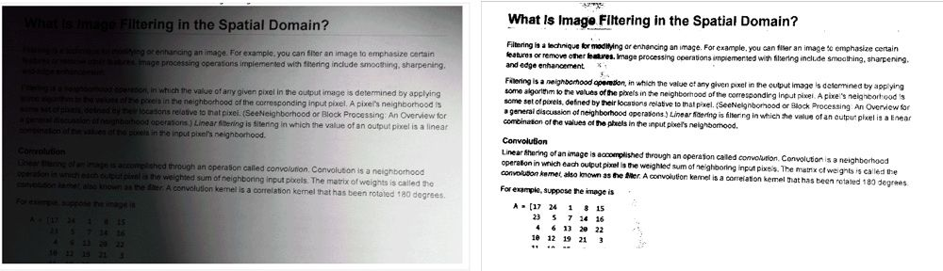
Applications
Separating text from background via thresholding

Slide 5
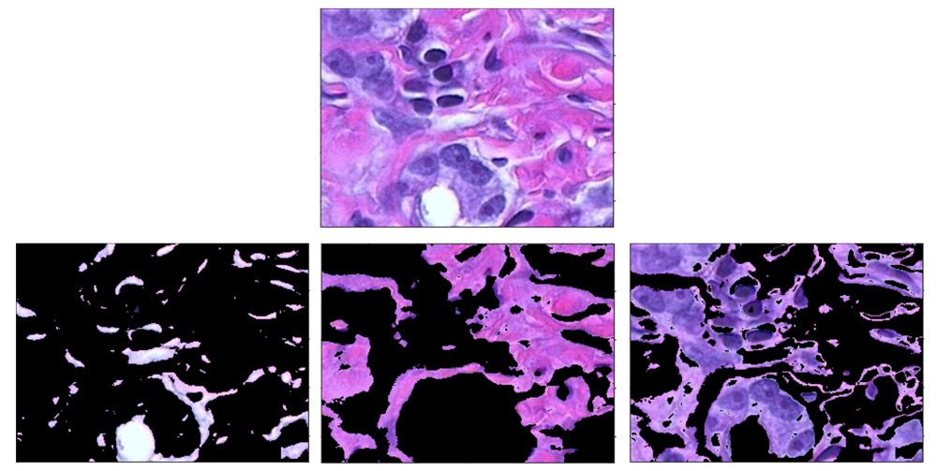
Applications
Tissue Segmentation - stained with hematoxylin and eosin (H&E).

Slide 6
Methods of segmentation
AI/ML based:
Deep CNNs - Unet, MaskRCNN
Need lot of training examples
Algorithmic:
Thresholding, Hough Transform
Clustering (K-Means) (no training)
Active Contours (no training)
ASM, AAM ( training required)
Graph Cuts (no training)

Slide 7
Graph Cuts
An image is represented by a graph, where each pixel is a node and the edge weight to neighboring pixels is determined by the similarity between pixels.
The goal is to cut the edges of a graph in such a way that groups similar pixels together. In other words, the edges between similar pixels are preserved and dissimilar pixels are cut.

Slide 8
Graph Cut with Max-Flow
To find the optimal cut that separates a foreground from the background, GraphCut sets up the task as a max-flow problem.
Max-Flow Problem: Given a “source” vertex, a “sink” vertex and a network with vertices and edges between those terminals, how much "flow" can the network process at a time? One way to think about this is how much water can flow out of the source and into the sink?
Flow can mean anything, but typically it means data through a computer network, number of supply trucks on a roads, etc.

Slide 9
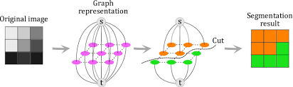
Graph Cut with Max-Flow

Slide 10
Max Flow = Min-cut
All networks, whether they carry data or water, operate pretty much the same way. The network wants to get some type of object (data or water) from the source to the sink.
The bottleneck for the amount of that object that can be passed through the network is the smallest connection between disjoint sets of the network. Even if other edges in this network have bigger capacities, those capacities will not be used to their fullest. These bottleneck edges will be a part of the Min-cut.

Slide 11
Algorithms to find Min-Cut/Max-Flow
Ford-Fulkerson- Runtime = O(U*E), u is max-flow and V is # of nodes
Edmonds-Karp = O(V *E^2)
Pre-flow Push = O( V^2 *E) – One of the of fastest.
Run times are important since we have a large number of pixels/Nodes and K-edges per Node.

Slide 12
Algorithms to find Min-Cut/Max-Flow
Ford-Fulkerson- Runtime = O(U*E), u is max-flow and V is # of nodes
Edmonds-Karp = O(V *E^2)
Pre-flow Push = O( V^2 *E) – One of the of fastest.
Run times are important since we have a large number of pixels/Nodes and K-edges per Node.

Slide 13
Pre-flow Push algorithm
Residual Graphs: It indicates how much more flow is allowed in each edge in the network graph. If there are no augmenting paths possible from S to T in this graph, then the flow is maximum. There will be (reverse)edges in this graph not present in the original Flow graph presented.
Each Node is given a height/label. Initially, all nodes except source (height = |V|) have height 0.
Each Node has some excess flow= In_flow – Out_flow >=0.
Push: If a node has excess flow and edge capacity to an adjacent node 1 unit lower is nonzero, then we push flow to the node.
Relabel: if node has excess flow but is lower than adjacent nodes, relabel it/Increase its height.
After the algorithm terminates (no more nodes with excess flow), the set of nodes reachable from the source in the residual graph is the FG.

Slide 14
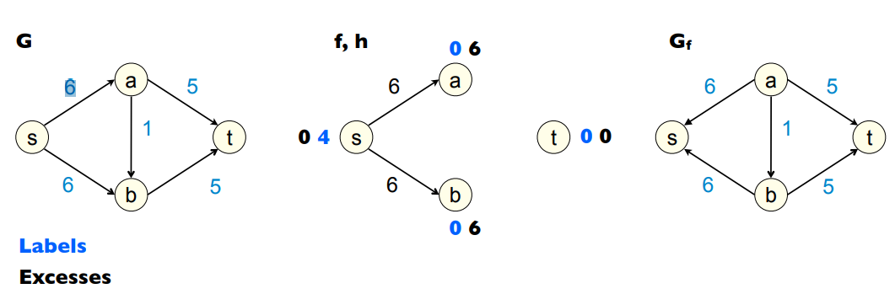
Pre-Flow Initialization
Example from: https://cseweb.ucsd.edu/classes/sp11/cse202-a/lecture9-final.pdf

Slide 15
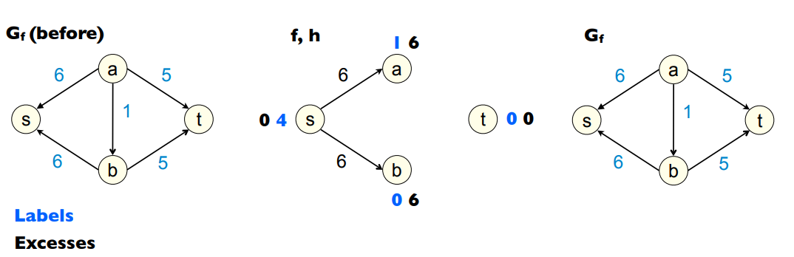
Relabel a

Slide 16
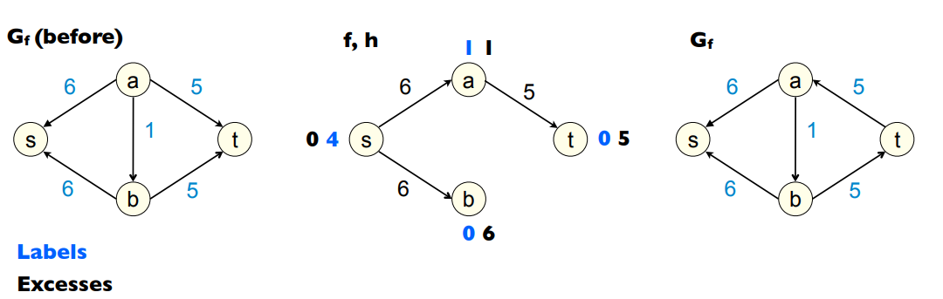
Push to t

Slide 17
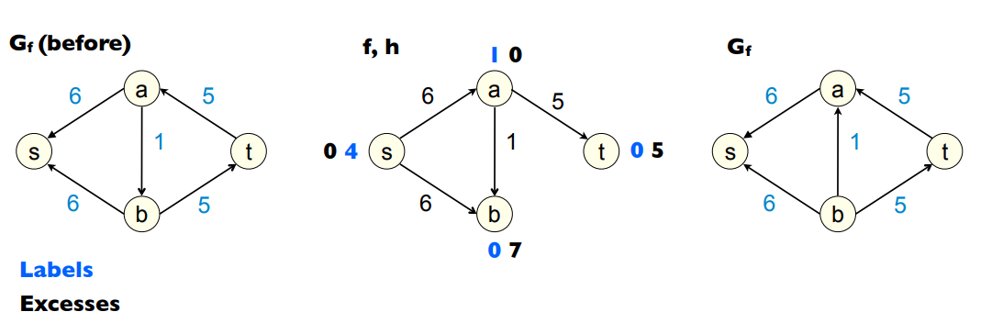
Push to b

Slide 18
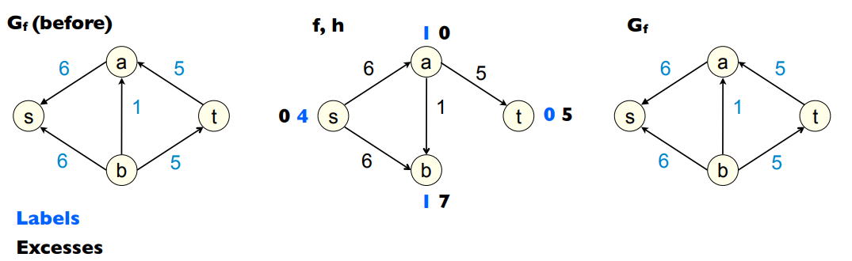
Relabel b

Slide 19
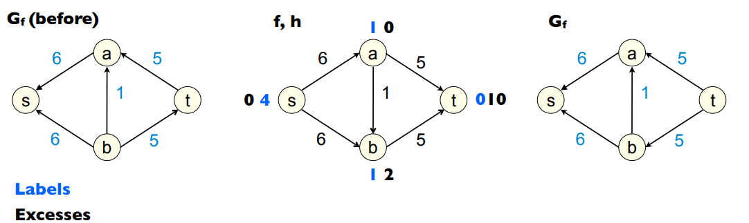
Push to t

Slide 20
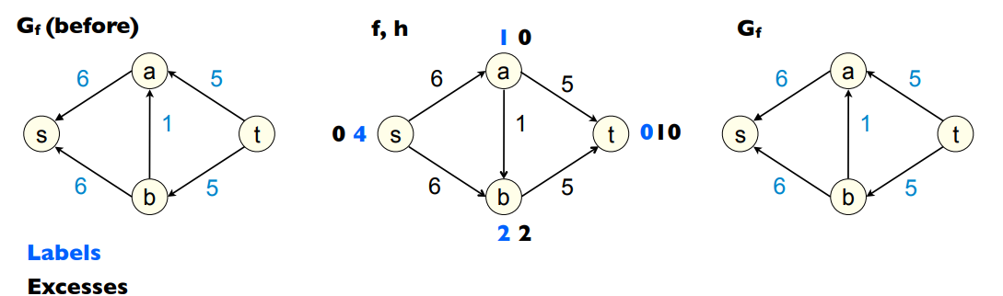
Relabel b

Slide 21
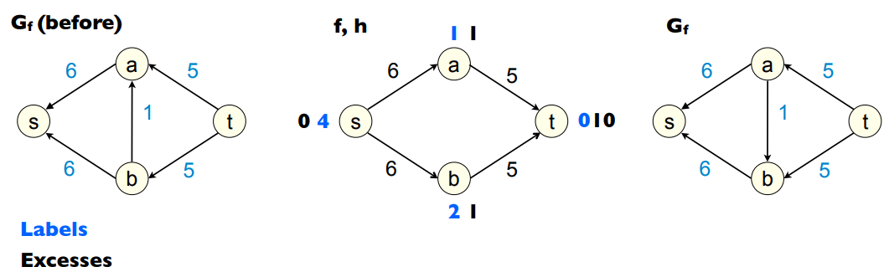
Push back to a

Slide 22
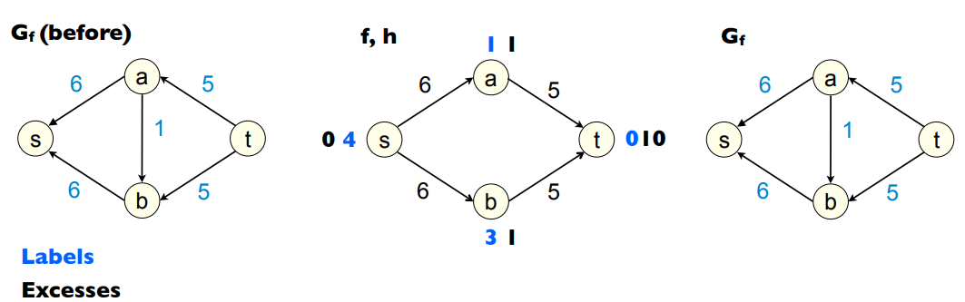
Relabel b

Slide 23
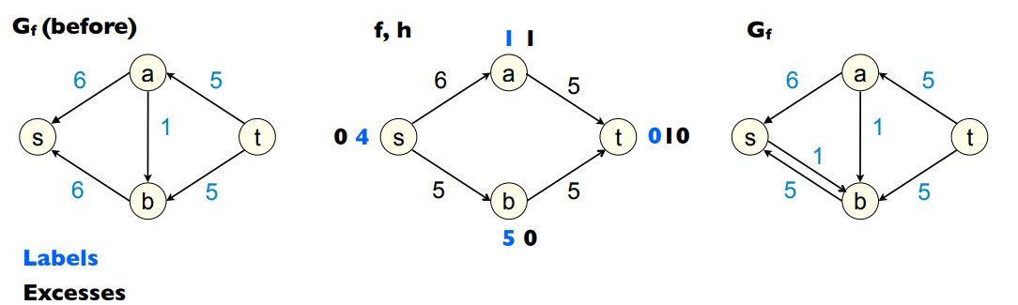
Relabel b till height greater than source and Push back to s

Slide 24
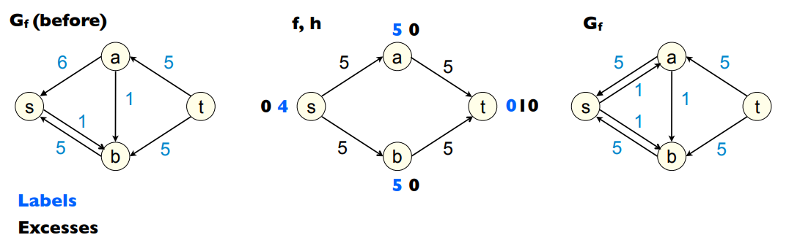
Relabel a till height > source and push back to source

Slide 25
GraphCut Graph Creation
How do we determine edge capacities in the Flow Network/ Image Graph?
2 types of connections:
N-links: Neighbor links. Edges to the adjacent pixels
T-links: Terminal links. Edges to the source or the sink.
Graph Cut is an interactive image segmentation method. The user marks a couple of the background and foreground pixels as seeds for the algorithm.
These pixels are used to create a histogram of intensities. One histogram each for the foreground and background.
From these histograms we can estimate the following probabilities: P(I_p|FG) and P(I_p|BG).

Slide 26
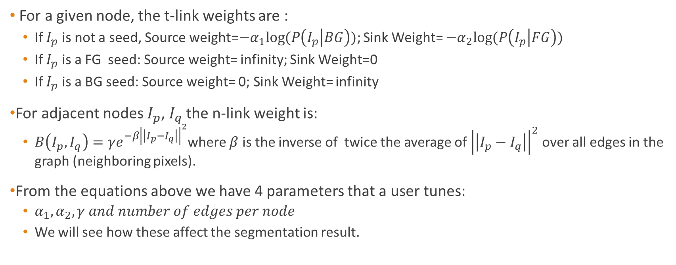
GraphCut Graph Creation
For a given node, the t-link weights are :
If $I_{p}$ is not a seed, Source weight=$−α_{1}log⁡(P\left(I_{p} | BG\right))$; Sink Weight= $−α_{2}log⁡(P\left(I_{p} | FG\right))$
If $I_{p}$ is a FG seed: Source weight= infinity; Sink Weight=0
If $I_{p}$ is a BG seed: Source weight= 0; Sink Weight= infinity
For adjacent nodes $I_{p}$, $I_{q}$ the n-link weight is:
$B\left(I_{p},I_{q}\right)={γe}^{{−β\left|\left|I_{p}−I_{q}\right|\right|}^{2}}$where $β$ is the inverse of twice the average of ${\left|\left|I_{p}−I_{q}\right|\right|}^{2}$ over all edges in the graph (neighboring pixels).
From the equations above we have 4 parameters that a user tunes:
$α_{1},α_{2},γ and number of edges per node$
We will see how these affect the segmentation result.

Slide 27
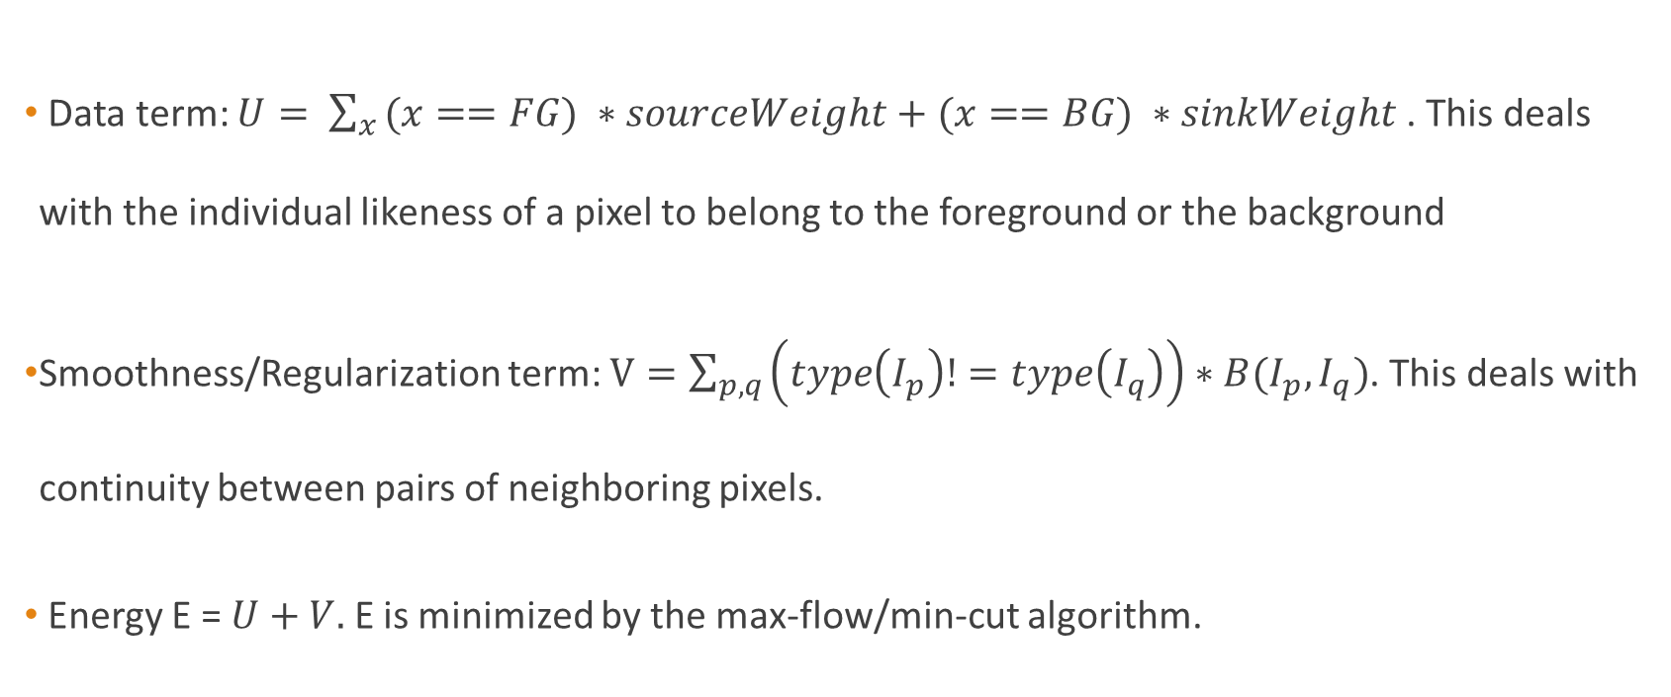
Graph Cut Objective Function
Data term: $U= \sum_{x }{(x==FG) ∗sourceWeight+(x==BG) ∗sinkWeight }$. This deals with the individual likeness of a pixel to belong to the foreground or the background
Smoothness/Regularization term: $V=\sum_{p,q}{\left(type\left(I_{p}\right)!=type\left(I_{q}\right)\right)∗B(I_{p},I_{q})}$. This deals with continuity between pairs of neighboring pixels.
Energy E = $U+V.$ E is minimized by the max-flow/min-cut algorithm.

Slide 28
Implementation
Get User to mark FG and BG
Learn histograms for FG and BG, using Gaussian kernel density estimation (sklearn python)
Create Graph as described on previous slides
Get the partition by applying the Pre-flow Push algorithm to calculate Max-flow/Min-cut
Generate Mask (Can optionally denoise(NLM) the Mask before being fed to the next iteration to re-learn the kernel density)
Repeat Steps 2-5 till convergence or for specified number of iterations.
Some post-processing(trimap generation and border matting) to refine object boundary

Slide 29
Experiments

Slide 30
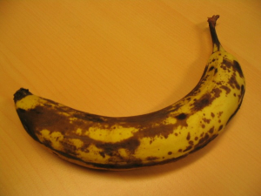
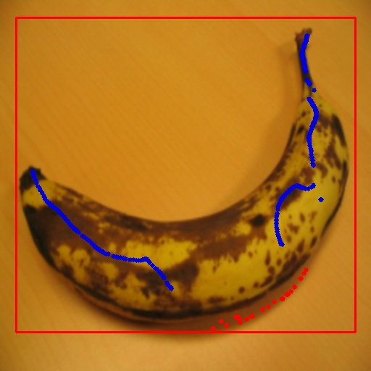
Alpha Experiments
Input Image
User Seeded Image

Slide 31
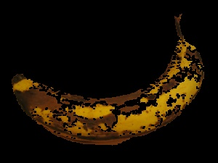
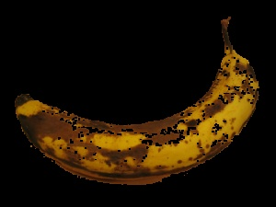
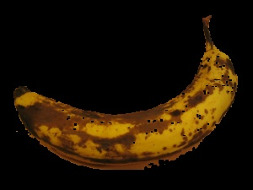
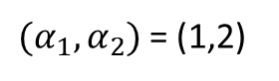
Results (without denoising Mask)
Source weight=$−α_{1}log⁡(P\left(I_{p} | BG\right))$; Sink Weight= $−α_{2}log⁡(P\left(I_{p} | FG\right))$
${(α}_{1},α_{2})$= (1,2)
(1.1,1.2)
(1.9,1.2)
1 iteration. Everything else constant.

Slide 32
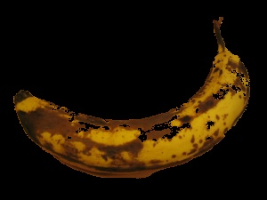
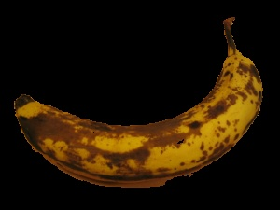

Results (with denoising Mask)
Source weight=$−α_{1}log⁡(P\left(I_{p} | BG\right))$; Sink Weight= $−α_{2}log⁡(P\left(I_{p} | FG\right))$
${(α}_{1},α_{2})$= (1,2)
(1.1,1.2)
(1.9,1.2)
1 iteration. Everything else constant.

Slide 33
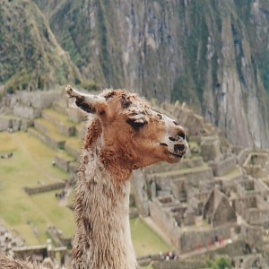
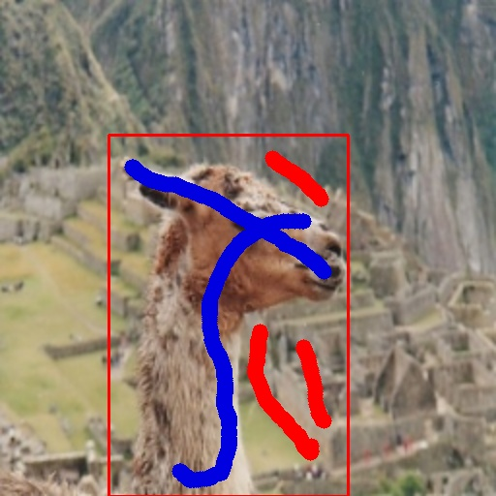
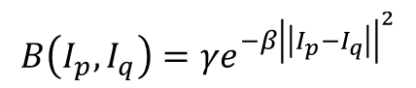
Gamma Experiments
$$B\left(I_{p},I_{q}\right)={γe}^{{−β\left|\left|I_{p}−I_{q}\right|\right|}^{2}}$$
Input Image
User seeded
1 iteration. Everything else constant.

Slide 34
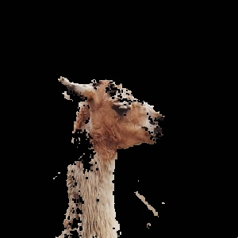
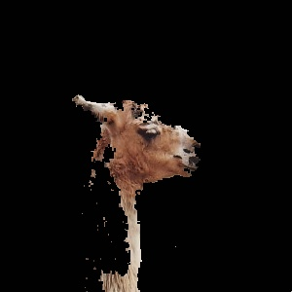
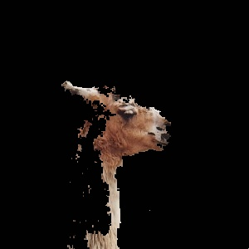
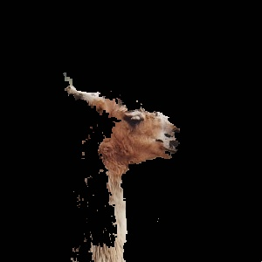
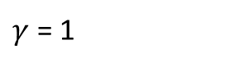
Results without denoising
$$B\left(I_{p},I_{q}\right)={γe}^{{−β\left|\left|I_{p}−I_{q}\right|\right|}^{2}}$$
$γ$ = 1
50
100
500
1 iteration. Everything else constant.

Slide 35
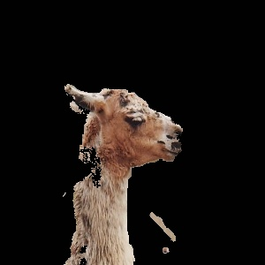
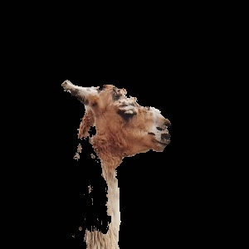
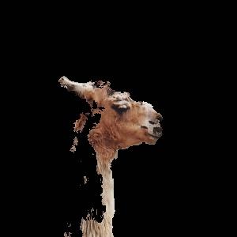
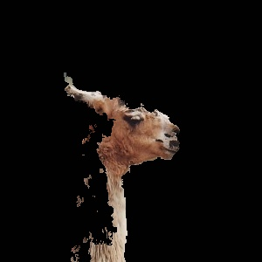
Results with denoising
$$B\left(I_{p},I_{q}\right)={γe}^{{−β\left|\left|I_{p}−I_{q}\right|\right|}^{2}}$$
$γ$ = 1
50
100
500
1 iteration. Everything else constant. As gamma gets larger, the n-links are stronger than the t-links (source link specifically as we have fewer pixels in the FG hist in the first iteration) so the source link is cheaper to cut. Higher gamma would also prevent color leaks and tighter boundaries in subsequent iterations.

Slide 36
Neighbor Experiments
Input Image
User seeded
1 iteration. Everything else constant.

Slide 37
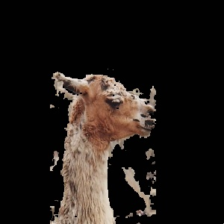
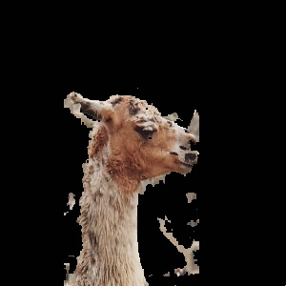
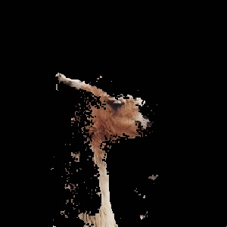
Results without denoising
# neighbors = 8
24
48
1 iteration. Everything else constant. Decrease in param increases color leaks. This is because a decrease in number of edges and connectivity of the graph places more weight on the data terms of the energy function, giving more importance to the color (and hence likeness to the background and foreground color models) of an individual pixel rather than its relation to the surrounding region. I used gamma =10 and alphas(2,1.2) to demonstrate this. Similar effect to gamma.

Slide 38
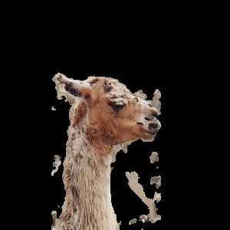

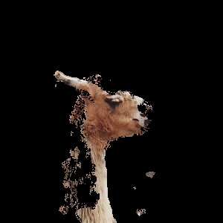
Results with denoising
# neighbors = 8
24
48
Since there are more edges, it becomes less likely to preserve source-links in favor of the n-links unless the source link strength is very strong (closer to the seeds).

Slide 39
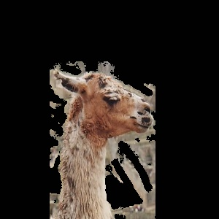
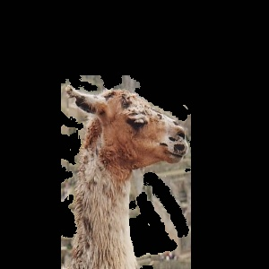
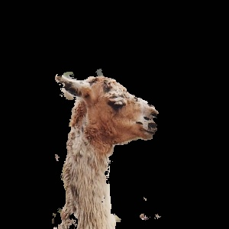

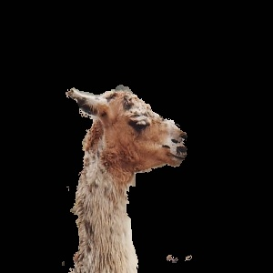
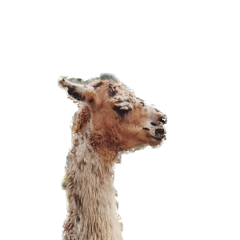
Iteration with denoising and final-border matting

Slide 40
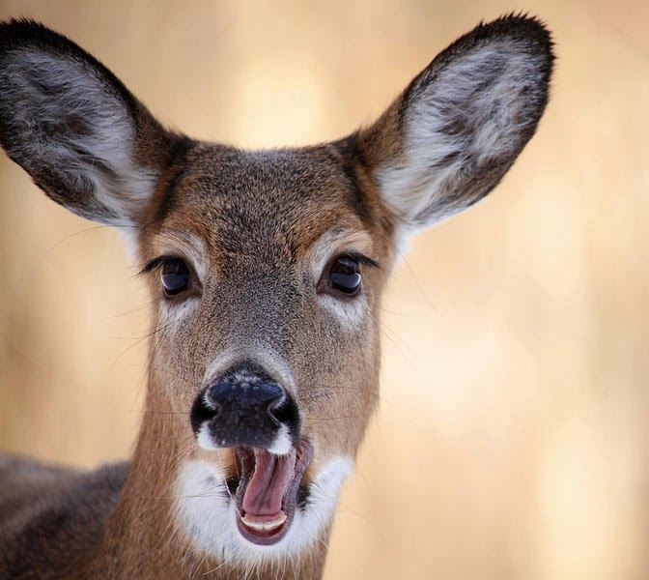
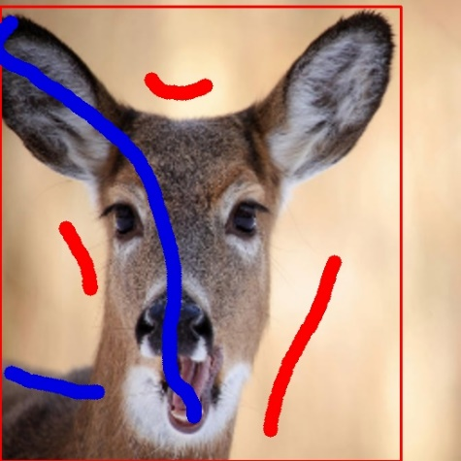
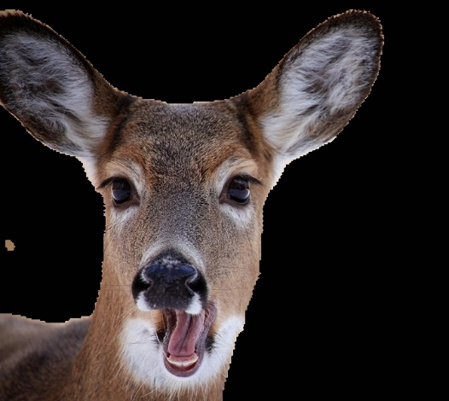





Deer Segmentation

Slide 41




Coins

Slide 42




Corpus Callosum

Slide 43




Corpus Callosum

Slide 44




Corpus Callosum

Slide 45
Thank You

